Slide 1
Part Four
Port security

Slide 2
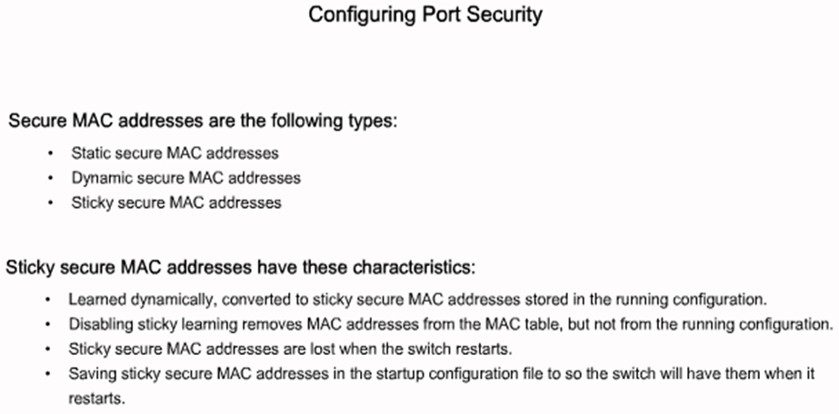
Configuring Port Security

Slide 3
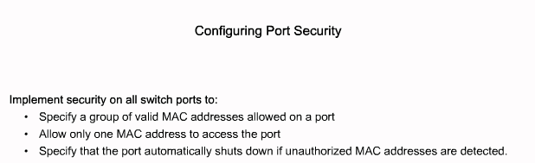
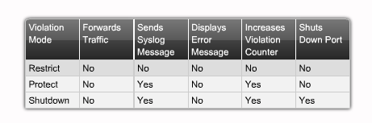
Configuring Port Security

Slide 4
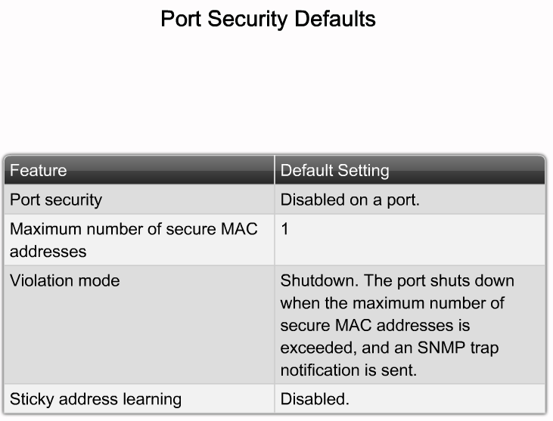
Configuring Port Security
Describe the Cisco IOS commands used to disable unused ports
Notes:
Graphic 2.4.6.2

Slide 5
Configuring Port Security
Catalyst 2950 Series
wg_sw_2950(config-if)#switchport port-security [mac-address mac-address] | [maximum value] | [violation {protect |restrict | shutdown}]
wg_sw_2950(config)#interface fa0/1
wg_sw_2950(config-if)#switchport mode access
wg_sw_2950(config-if)#switchport port-security
wg_sw_2950(config-if)#switchport port-security maximum 1
wg_sw_2950(config-if)#switchport port-security mac-address 0008.eeee.eeee
wg_sw_2950(config-if)#switchport port-security violation shutdown
Notes:
Layer 2 of 2
Note: When the switch-sticky learns a MAC address on a secured port, the switch will make that MAC address a permanent address.

Slide 6
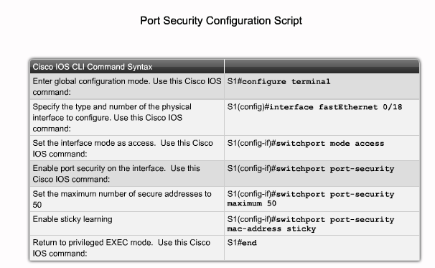
Configuring Port Security

Slide 7
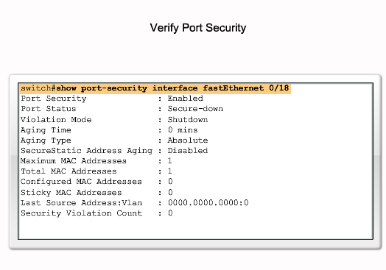
Configuring Port Security

Slide 8
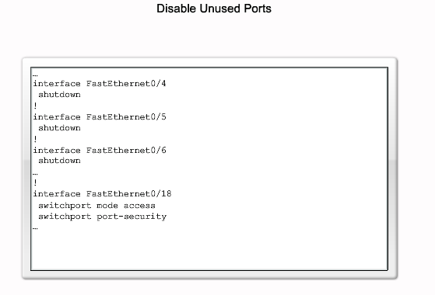
Securing Unused Ports

